Slide 1
Telehealth: A Primer for Social Work Interns*
*Special thanks to William James College for sharing this content.
Eugenia Correia Knight, LICSW
Director of Practicum Education
Notes:
This presentation is supported by the Health Resources and Services Administration (HRSA) of the U.S. Department of Health and Human Services (HHS) as part of an award totaling $2.7 million The contents are those of the author(s) and do not necessarily represent the official views of, nor an endorsement, by HRSA, HHS or the U.S. Government.

Slide 2
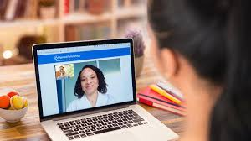
Why Telehealth?
Preserving public health
Reduce barriers to treatment: travel time, childcare, transportation, time off from work, privacy, comfort, stigma, illness
Increase flexibility for client and provider
Cost savings
Continuation of care in times of illness, crisis, pandemic, quarantine

Slide 3
Effectiveness of Telemental Health - “Tele-Social Work”
A 2013 literature review found that telemental health was effective for assessment and diagnosis across multiple populations (adult, geriatric, child/adolescent, and various ethnic groups)
Telemental Health Research Catalog - Center for Connected Health Policy: A 2018 compilation and review of telemental health studies published in peer reviewed journals showed:
Improved access to treatment
Cost effectiveness of telemedicine-based collaborative care for depression
Efficacy of psychotherapy via telehealth for underserved and older adults
Satisfaction in veteran population with decreased travel time and travel costs, fewer crowds associated with treatment via telehealth
Effective deployment of treatment programs for PTSD, ADHD, anger management, parent guidance delivered via technology
Hilty et. al (2013) The Effectiveness of Telemental Health: A Meta-Analysis

Slide 4
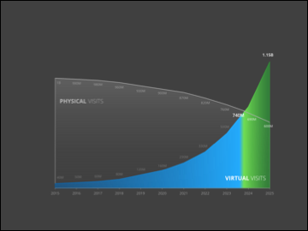
Future of Telehealth: Virtual Visits Will Eclipse In-Person Visits

Slide 5
Key Goals
Connection (technological and interpersonal)
Engagement
Therapeutic progress

Slide 6
Privacy, Security, Licensing, and Regulation
Telehealth standards vary from state to state
In some states, the provider (Practicum Instructor) must be licensed to practice in the state in which the patient is located at the time of each visit; in others there are no restrictions on provider’s location
Utilize technology that is HIPAA compliant (Doxy.me, certain Zoom platforms)
Some of these restrictions are relaxed during COVID-19
All communications and documentation must occur on private, secure, and HIPAA compliant software and platforms
Maintain professional vigilance when working from home.
Do not save Private Health Information (PHI) to personal devices
Adhere to all standards, requirements, and recommendations made by the IT teams at your place of internship

Slide 7
Telehealth Appropriate Care
Telehealth Appropriate Conditions:
Conditions where traditional talk therapy is recommended
Conditions within scope of practice of clinician competence
Inappropriate Conditions:
Inability to use, or lack of access to appropriate technology
Current suicidality, homicidality, or psychosis
High likelihood of crisis
Need for medical intervention (detox or inpatient care)

Slide 8
Telehealth with Children and Adolescents
Younger children may find it more difficult to engage for 45 minutes
Key factor is the individual child’s ability to engage
Incorporate elements of play like stories and word games
Tap into child/adolescent’s innate interest in technology

Slide 9
Preparing for a Visit - Technology
Check your own technology for readiness before
starting each patient encounter
Using earbuds with mic may help your own audio
Your computer audio picks up a great deal of background noise, be aware of noise from typing, mouse clicks, text alerts

Slide 10
Preparing for a Visit - Environment
Be sure your setting is client-ready
Clean, uncluttered, professional background
Examine your space from the perspective of a client, even small changes can help convey professionalism
During test visits, pay attention to what is in the client’s field of vision and adjust accordingly

Slide 11
Environment - continued
Lighting is important: The primary light source should be in front of your face – avoid any backlighting from windows
Use white noise, “Do Not Disturb” signs, and locks on doors to protect the privacy of sessions
Do not use your bed as a place to sit. If your bedroom is your only private space, pull in a chair and have the wall (not a pillow or headboard) as your background
If you need to use a virtual background, make sure it is calming and appropriate.

Slide 12
Appearance
Dress as you would for any professional encounter in an office setting
Remember to dress appropriately from head-to-toe in the event that you unexpectedly have to stand up during the session
Be aware of eye contact and look at the webcam, not the screen
Be mindful of potential interruptions from pets, children or other sources

Slide 13
Starting the Visit
Inform your client that you are alone and the conversation is private. You many want to mention any means used to maintain privacy.
Answer any questions about technology and confirm that the client can see you and hear you
If you anticipate disruptions, discuss ahead (both parties)
Inform client of anything you do off screen (note taking, grabbing a book, looking up resources for them on a separate tab)

Slide 14
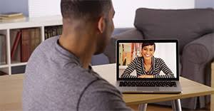
Client Engagement
Greet the client warmly as if you were greeting in person
You may want to use more words to describe what you are thinking and feeling as some of the non-verbal communication is lost
Most people feel that the technology feel tends to fade away after the initial few minutes

Slide 15
Ending the Session
Create plan for next steps and schedule follow-up
Review your plan
Check in re: usefulness and tone of telehealth venue
Invite the client to be the one to “end” the session (hang up or sign off). This allows them to feel a sense of control and ensures they aren’t inadvertently or abruptly cut off.

Slide 16
COVID-19 Check-in
Anxiety and worry about the coronavirus itself
Is the client caring for someone who is ill?
Has the client lost anyone to COVID?
What are the changes in work, school, or personal routines?
Changes in family structure and interactions
Financial changes or crises?

Slide 17
Resources
https://www.telehealthresourcecenter.org/

